Slide 1
Coverage Report
Announcement & Kickstarter
Notes:
S’assurer qu’il s’agisse du dernier logo...

Slide 2
Summary (Press)
Quick recap & Objectives
Global Coverage : overviews
Press releases timeline
PR Actions
Our collaboration
Analysis: How good did we do?
Analysis: Targeting it right
Analysis: Anticipating the next steps
Highlights

Slide 3
Quick Recap & Objectives
Tactical Adventures - Independent Studios created in November 2018
Main objectives :
Game announcement :
Wide distribution to specialist, B2B & mainstream media
Deal with big outlet for interviews
Gamescom
Let the medias know about Tactical Adventures presence at Gamescom 2019
Book meeting with medias
Let them spread the news about the incoming Kickstarter & Demo
Kickstarter
Draw public attention with medias
Grow backers & community numbers

Slide 4
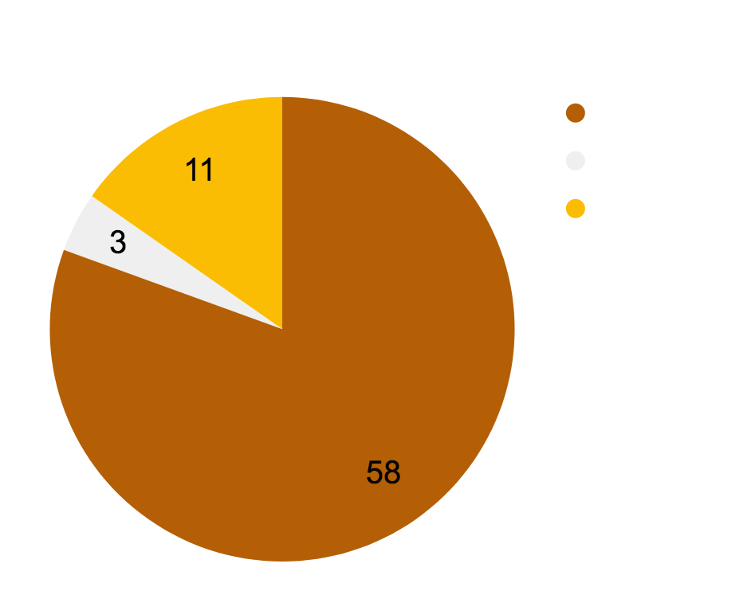
Global coverage : Overview
36 different french medias made articles about Solasta, for a total of 72 articles
Top Medias
Jeuxvideo.com : 7 articles
Rpgjeuxvideo.com : 7 articles
Geekgeneration.fr : 6 articles
Warlegend.net : 5 articles
Gamekult : 4 articles
Gamalive.com / Gameblog.fr / Jeuxonline.info : 3 articles
Notes:
FAIRE UN CAMEMBERT DE ÇA

Slide 5
Press Releases : Timeline
june 25
aug 19
sept 3
Game Announcement
Kickstarter Announcement
Kickstarter launch
sept 24
sept 30
oct 7
WotC partnership
Kickstarter funded
End of the Kickstarter

Slide 6
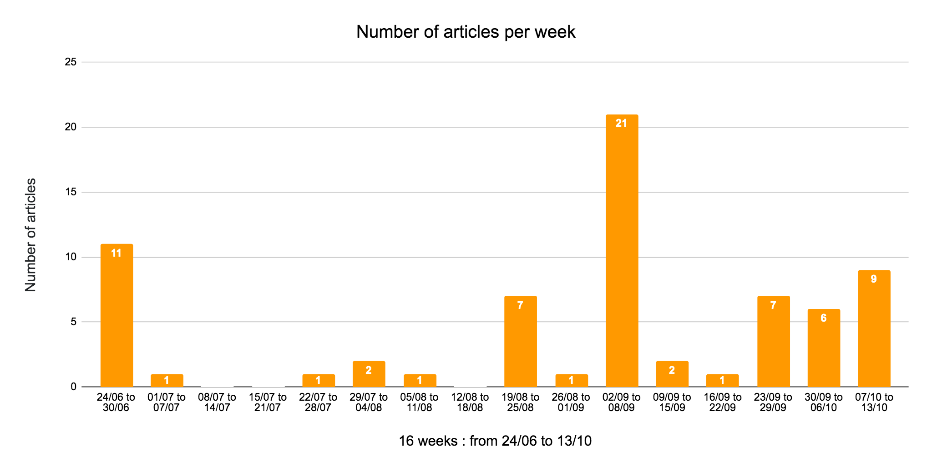
Temps forts
Annonce jeu, Gamescom, début Kickstarter, réussite / fin KS
Une slide par temps fort : objectifs + résultats
courbe des retombées par semaine / 3 mois = 12 semaines

Slide 7
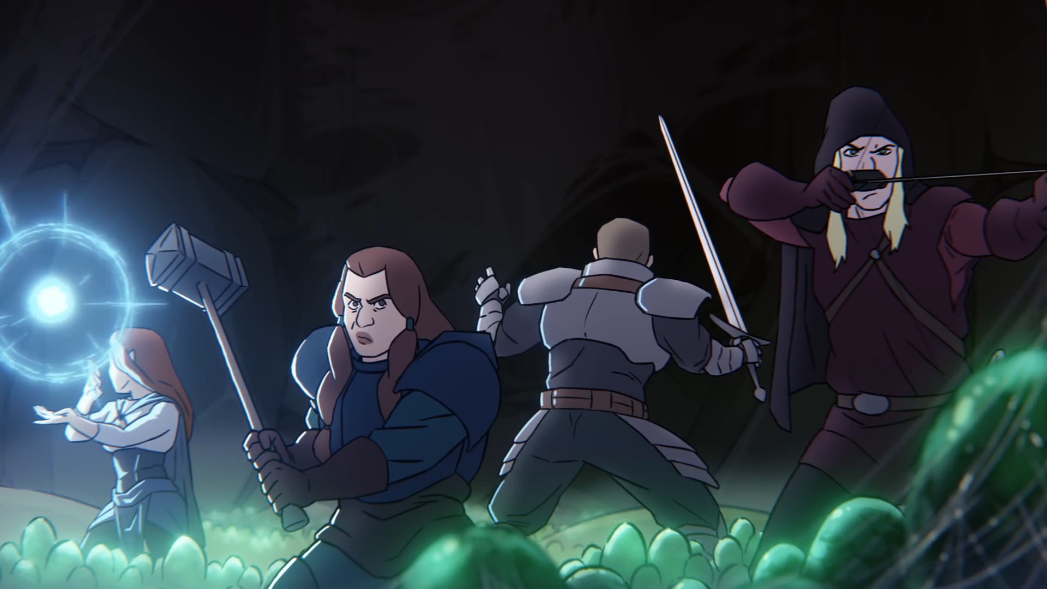
PR actions: Solasta - CotM announcement
Press release date: 25/06
Coverage: 13 news
How did we perform: The announcement was pretty good. We got the biggest french medias attention (Gamekult, JVC, Gameblog) and obtained interviews too.
High quality assets (dev diary, animated trailer, arts) helped to define the project, even with no in-game elements
The hype is real !

Slide 8
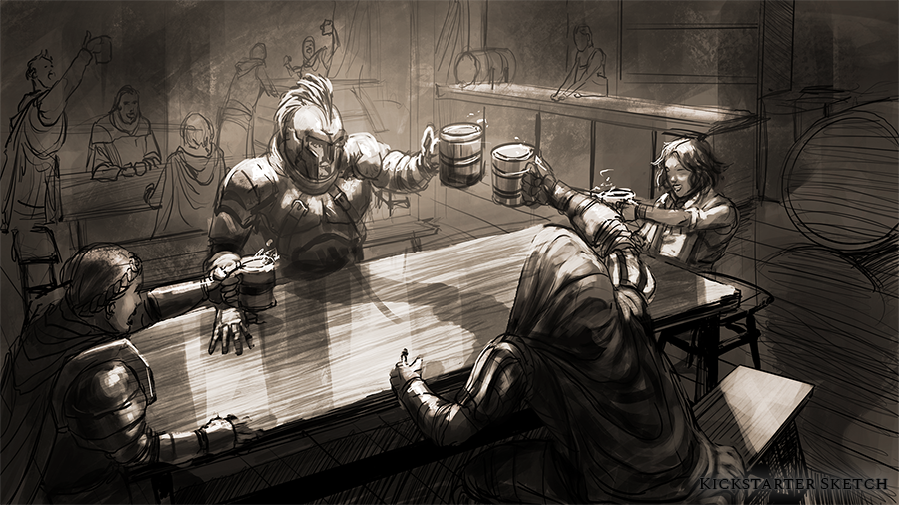
PR actions: Kickstarter’s date announcement
Press release date: 19/08
Coverage: 4 news (skewed numbers because many websites announced the Kickstarter date in their previews, which were releasing at the same time)
How did we perform: The Kickstarter date announcement was pretty slow by itself, since it was a few days between the Gamescom, with only a few screenshots.

Slide 9
PR actions: Gamescom
Press release date: 20-21/08
Coverage: 8 previews
How did we perform: We obtained 12 meetings over one day and a half (and had to decline some proposition in order to keep slots for the other territories). We can call it a success and it definitely helped to set the trend for the Kickstarter launch

Slide 10
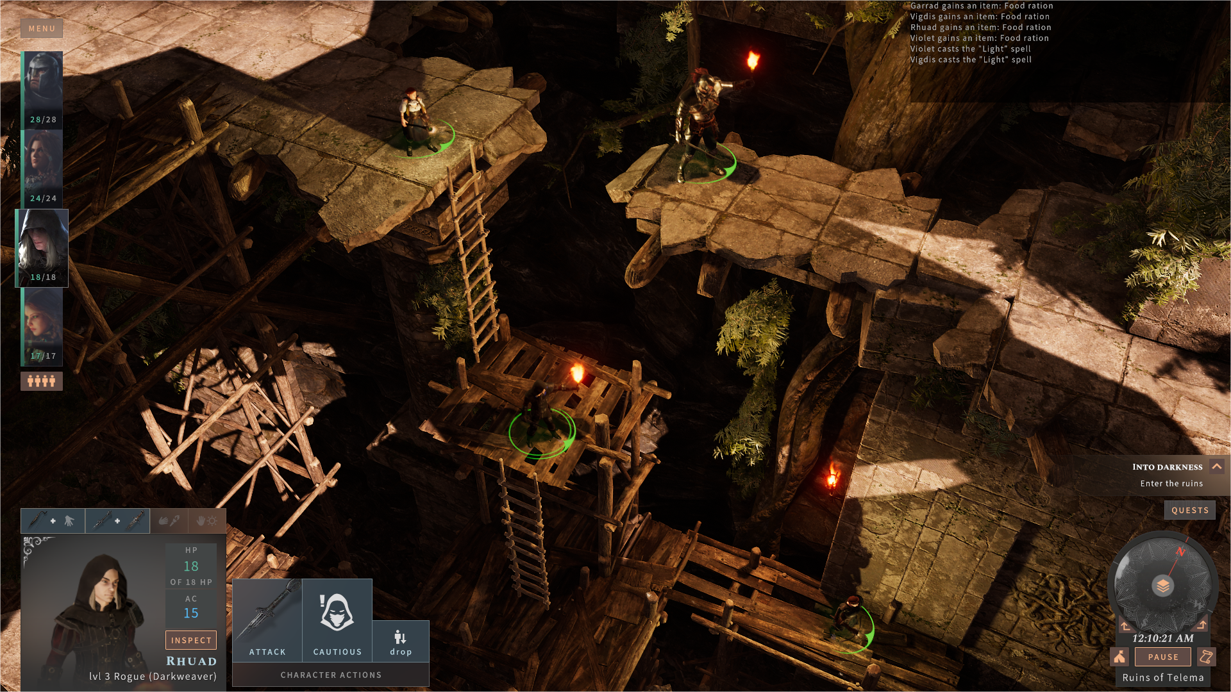
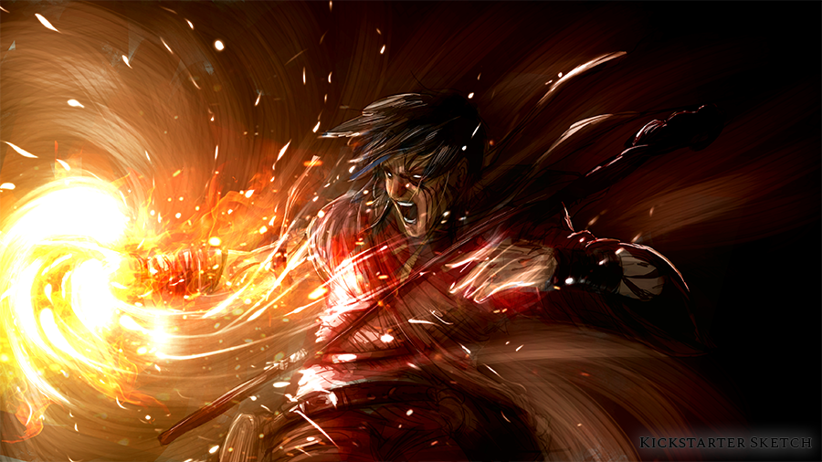
PR actions: Kickstarter launch
Press release date: 03/09
Coverage: 18 articles (14 news & 4 previews)
How did we perform: The Kickstarter launch press release was boosted by the Gamescom meetings, great assets (gameplay & lore trailers, arts, screenshots)

Slide 11
PR actions: Wizards of the Coast partnership
Press release date: 24/09
Coverage: 8 news
How did we perform: the pick-up of this press release was rather low. This announcement was very specific, and only but a few people could grasp the importance of the announcement through medias in France.

Slide 12
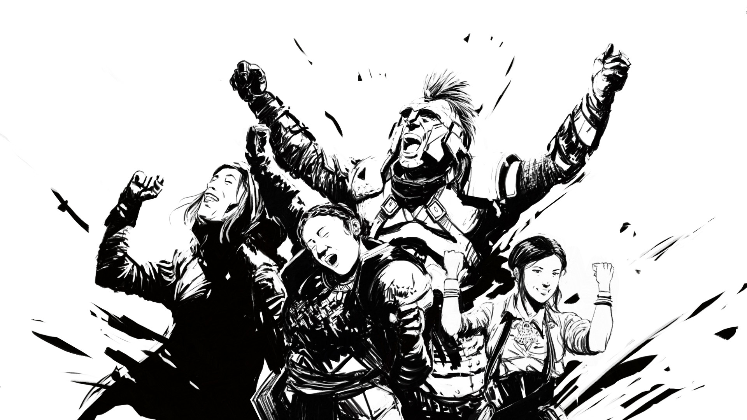
PR actions: Kickstarter conclusion
Press release date: 30/09 (100% funded) and 07/10 (Definitive results)
Coverage 100% funded : 4 news
Coverage Definitive results : 9 news
How did we perform: If the 100% funded press release pick up was rather low, we obtained better figures with the Definite Results Press Release. Making a summary of the stretch goals once the Kickstarter ends was definitely a good move !

Slide 13
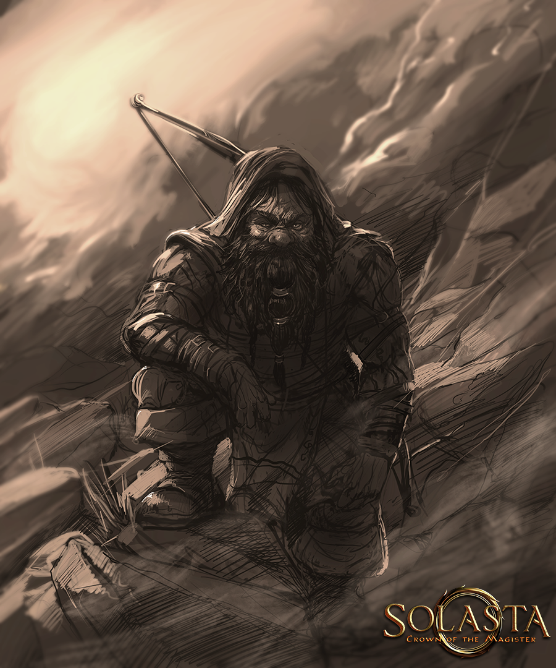
Influence coverage : Overview
7 content creators have made a total of 9 videos
generating 389555 cumulated views
Koinsky : 2 Youtube videos
Krayn : 1 Twitch stream and 1 Youtube video
Jean Baptiste Show : 1 Youtube video
Leif & Sukhoi : 1 Youtube video
Titavion : 1 Twitch stream
Desastre_show : 1 Twitch stream
Kittykathee : 1 Twitch stream
Notes:
FAIRE UN CAMEMBERT DE ÇA

Slide 14
Collaboration
Press agencies Worldwide (US, UK, GSA, FR) leaded by Pierre & Premier
Great workflow, coordination & team meetings overall
High quality assets for PR needs
Availability of Pierre, Mathieu and Emile who were open-minded on PR / influencers recommandations
Last minute changes went okay, even with US / Europe time difference
A few misunderstandings from time to time (without consequences) : a debriefing after every team calls would have helped

Slide 15
How good did we do? (1/2)
Let’s kick-start Solasta CotM - kind of a “Niche” game:
The main PR goal during the Kickstarter was to get fans’ attention mostly through specialized medias.
Several journalists told us they were reluctant to talk about a Kickstarter project…
… But Mathieu’s Background and BPI France investment helped to clear some of their doubts.
The Demo was also a great “confidence” move!
We targeted the Tactical / CRPG fans through identified Tactical / CRPG-savvy journalists, resulting in great previews.
The time is short!
We had 2 months and a half between the announcement of the game and the beginning of the Kickstarter, which is quite short!
Specialized medias attracted to indie games usually follow a game (and the dev team) for several months / years, before getting a high interest in it...
… But Solasta CotM was something else! Thanks to the game being “niche” with little offer on the market for Tactical / CRPG / D&D fans, we gained immediate interest from some medias

Slide 16
How good did we do? (2/2)
Gamescom: No Country for Indie games?
The Gamescom is highly concurrential with a lot of AAA… but is a great place to showcase the game to the press. Even in such a context, going to Gamescom is a credibility move for the game and the studio.
Difficulty with so much competition : to have deep previews of the game. Most journalists focused their attention on titles awaited by their community
Considering that, the event went really well (meetings with 10 medias and 2 influencers over one day and a half) with 15 subsequent articles / videos. These articles were mostly positives!

Slide 17
Targeting it right
Aim for the mainstream?
For Indie games, and more especially for a “Niche” game as Solasta CotM, it’s hard to go “big” into the mainstream medias. Also, it’s kind of a “glory move”, since the main targets are mostly hardcore players and D&D fans. In any case, we’ll have a few cards to play for the mainstream medias (A raising geek culture awareness, Mathieu as a french entrepreneur…).
D&D players Missing In Action
In France, except a few small medias, there’s no big, influential D&D press / medias and the community is scattered, but powerful. It will be useful to push hard on those smaller medias, but more importantly, to identify as many entry point to the D&D community as possible.

Slide 18
Anticipating the next steps
The press can’t ignore Solasta CotM anymore
As said before, a Kickstarter project always raises doubts among the press. A solid team background, demo and - more than anything - the success of the Kickstarter will help a lot to establish future contacts with the press, whether they’re already aware of the game or not.
Follow the market and adapt the communication towards journalists
PR-wise, it will be important to follow the Tactical / CRPG games which will be out between now and the final release of Solasta CotM (Baldur’s Gate III for example). Journalists & influencers attracted by this kind of games are picky (new quality standards will be set for them). During interviews, Tactical Adventures Team did great at showing how good they know their subject, and they will have to keep track of what’s going on around the Tactical / CRPG world.
Those journalists and Influencers also tend to react like fans, who can be heavily fired up... for better or worse. When addressing them, it’s mandatory to show transparency about what Solasta is (or isn’t), thus avoiding misunderstanding and backlash.

Slide 19
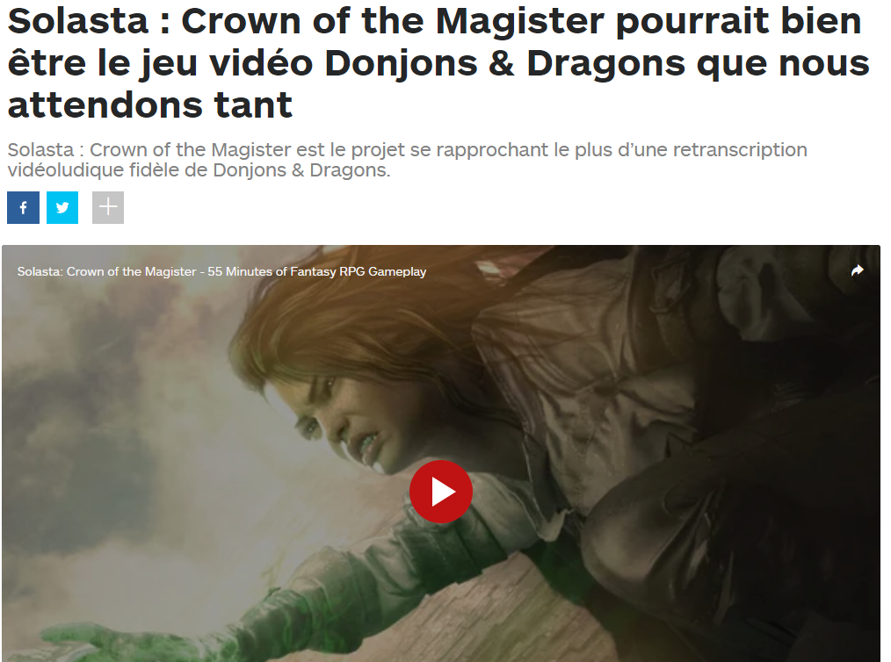
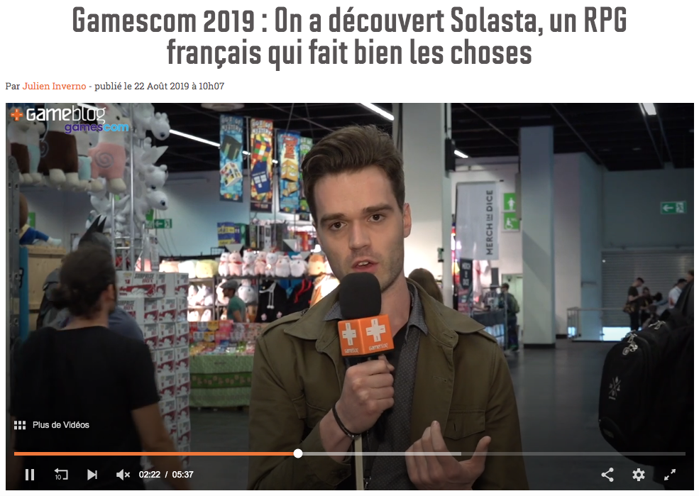
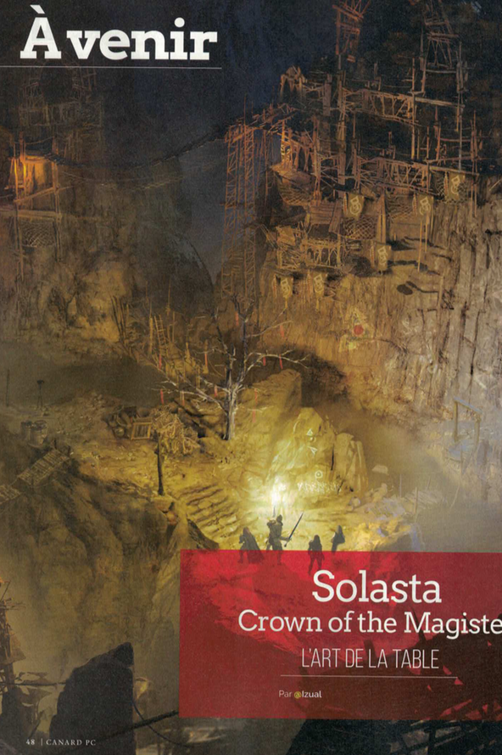
Press Highlights (1/3)

Slide 20
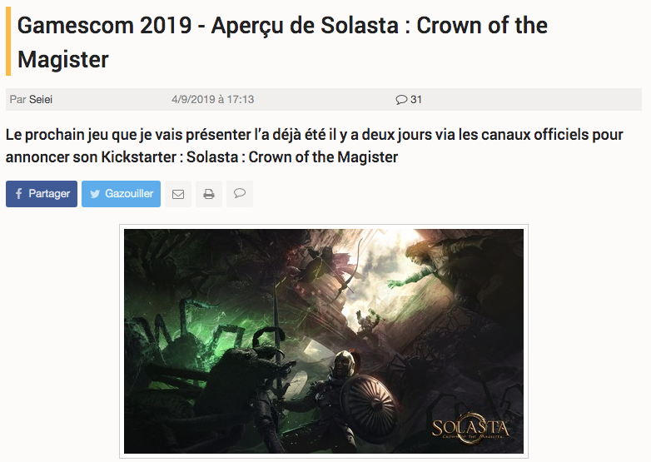
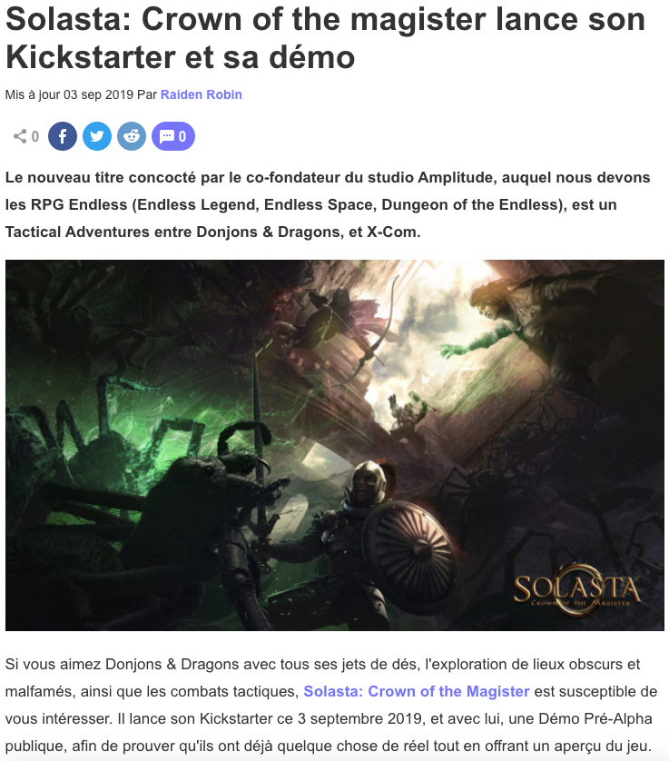
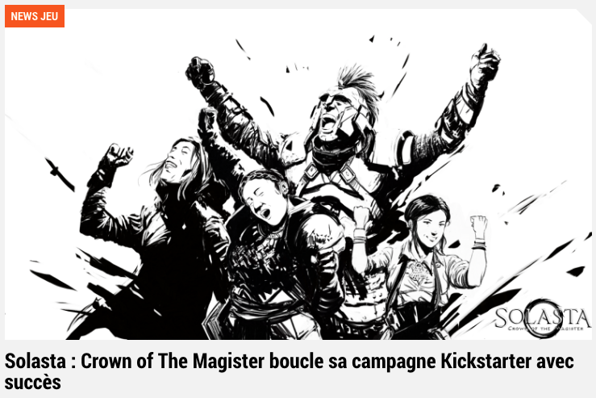
Press Highlights (2/3)

Slide 21
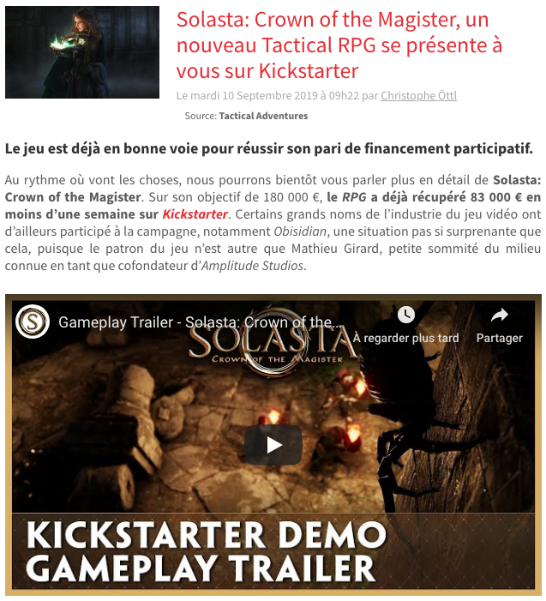
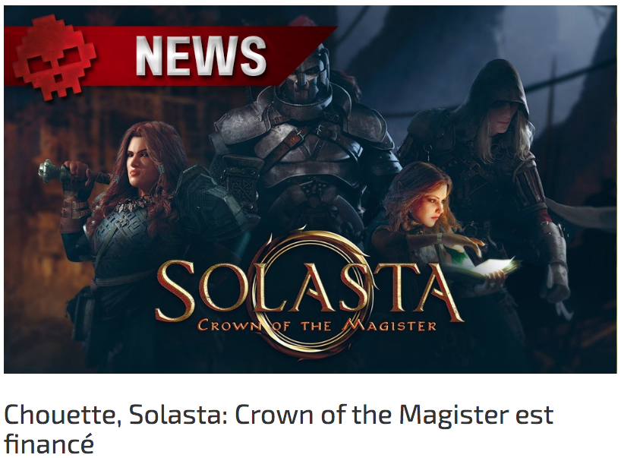
Press Highlights (3/3)

Slide 22
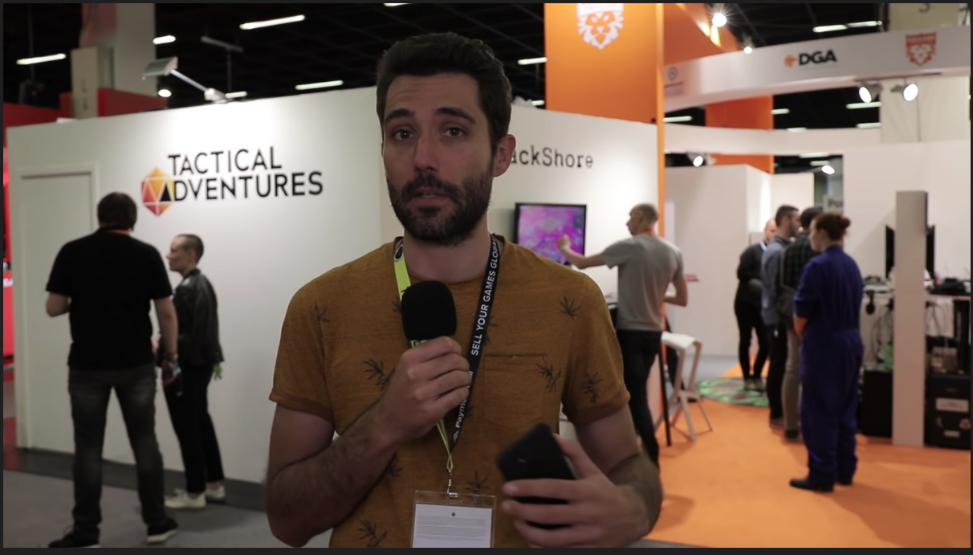
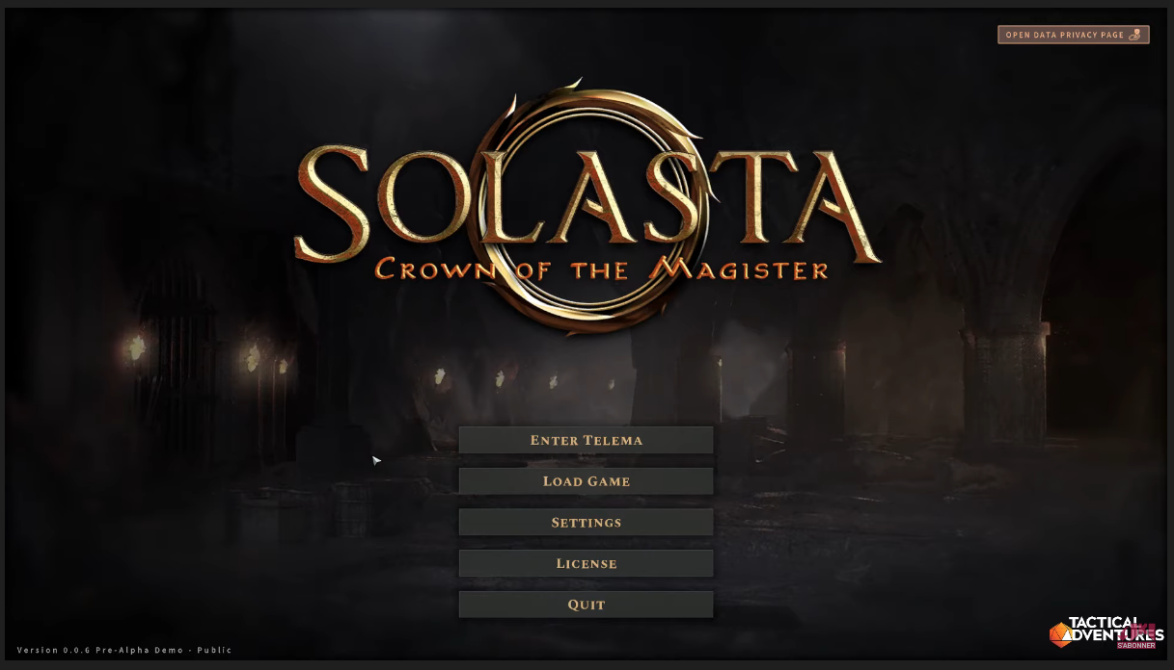
Influencers Highlights (1/2)
359 029 views 05/09/2019
2 vidéos : 11248 cumulated views 26/08/2019 & 03/09/2019
Notes:
nb influenceurs, nb views cumulées

Slide 23
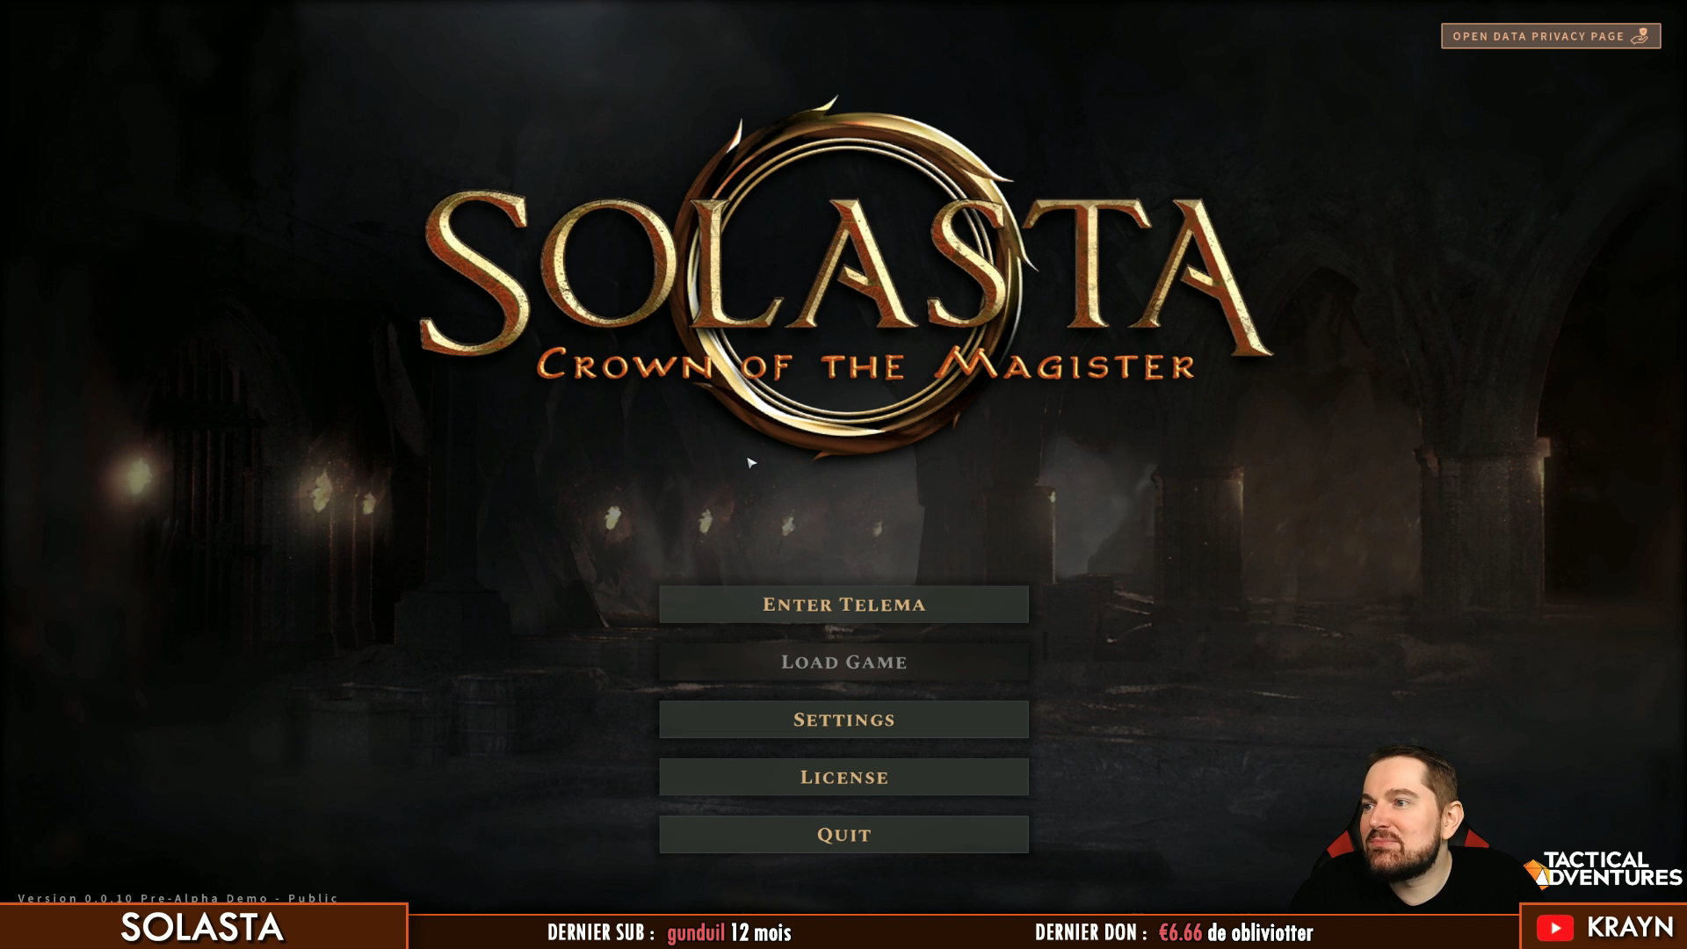
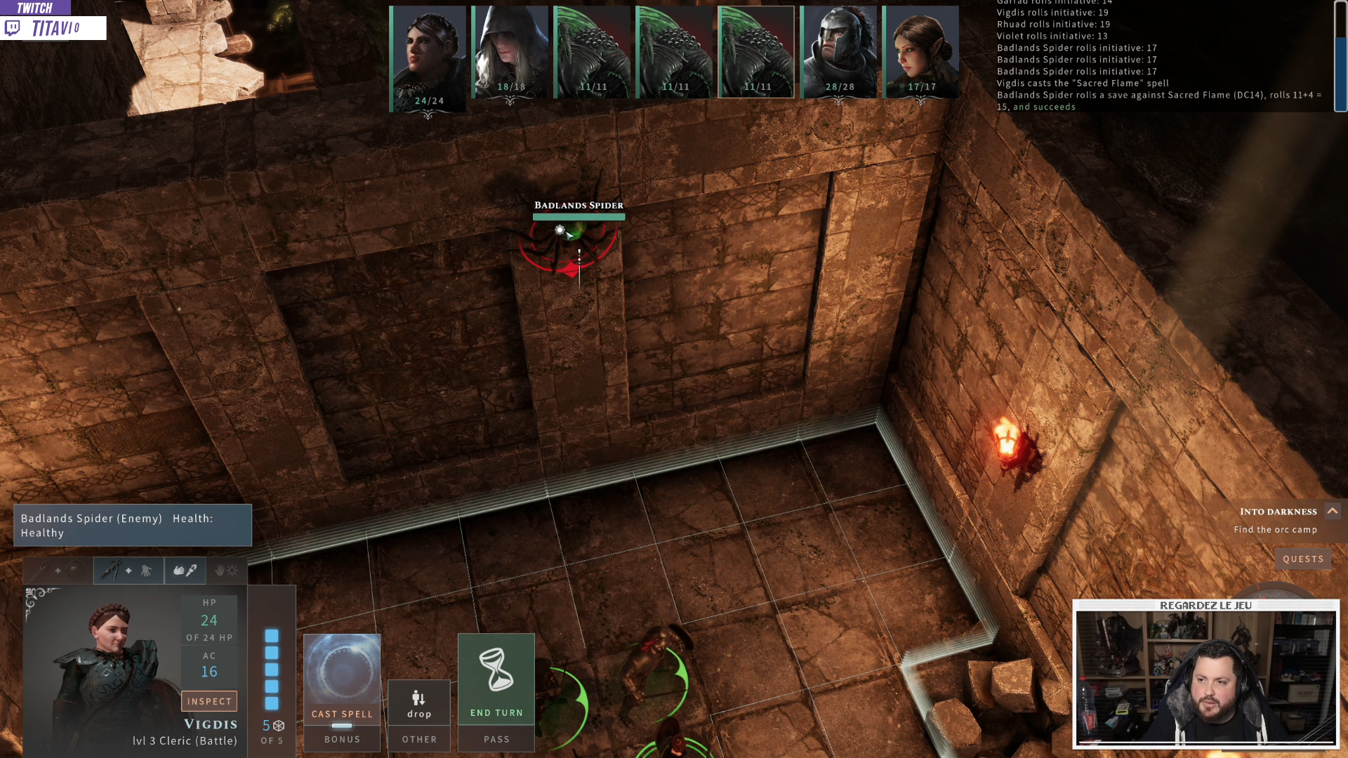
Influencers Highlights (2/2)
856 max viewers 2226 unique views 06/09/2019
512 max viewers 6164 unique views 07/10/2019

Slide 24
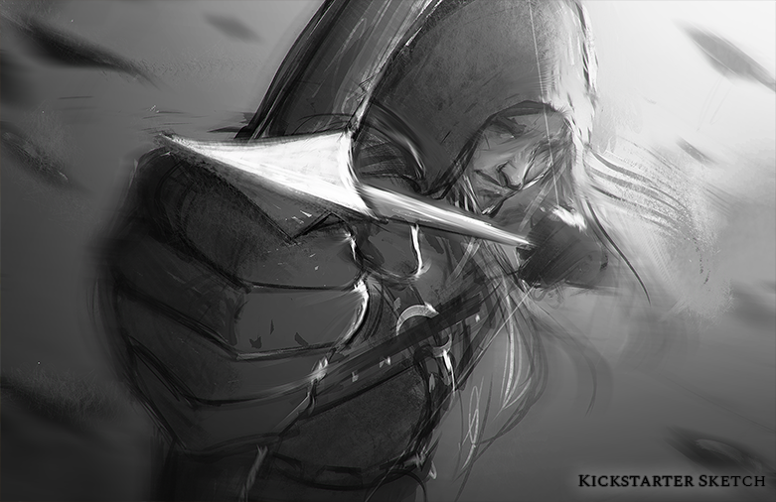
Thanks for Watching

